Slide 1

2.9 Highway Pavement and Material
JAIN POLYTECHNIC, BELAGAVI
15CE54T – Transportation Engineering
Presented by: Abhishek Amathe, L/CE

Slide 2
CONTENT
Subsurface highway drainage
Types of subsurface highway drainage

Slide 3
Subsurface highway drainage,
The increase in moisture content of the subgrade shall decrease its strength and stability. The variation in moisture content of the subgrade are caused by percolation rain water, fluctuation in ground water table, capillary water etc.
The main objects of sub surface drainage is to keep the highest water table level fairly below the level of subgrade so that the subgrade and pavement layers are not subjected to excessive moisture.
Methods of providing sub-soil or sub-surface drainage
Drainage in areas high water table
Drainage to control capillary rise
Drainage to control seepage flow

Slide 4
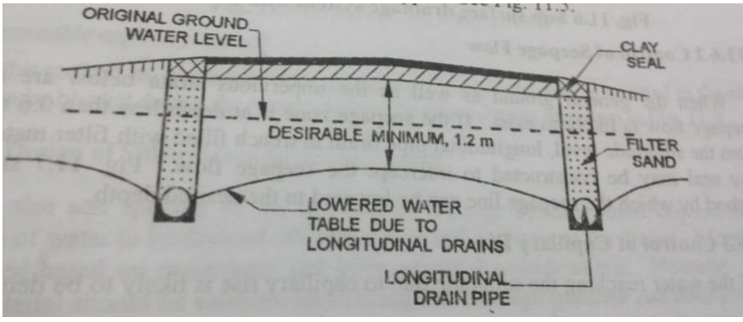
Drainage in areas high water table
If soil is relatively permeable, it may be possible to lower WT by constructing longitudinal drainage trenches with drain pipe and filter sand and top of trenches is covered with clay seal
If the soil is relatively less permeable, the lowering of ground WT may not be adequate. Hence in addition to the longitudinal drains traverse drains have to be installed at suitable intervals in effectively drain off the water.

Slide 5
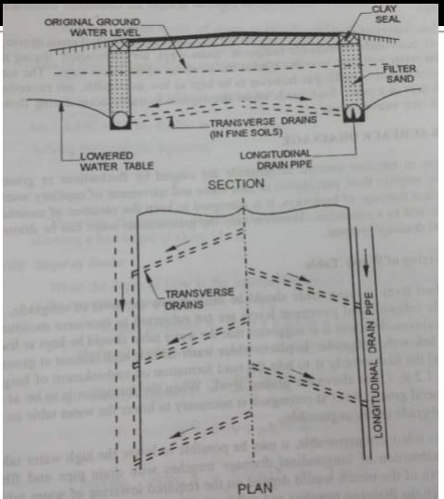
Drainage to control capillary rise
If the water reaching the subgrade due to capillary rise is likely to be detrimental, it is possible to solve the problem by arresting the capillary rise.
It can be done by following methods:
(a) A layer of granular materials of suitable thickness is provided during the construction of embankment, between the subgrade and the highest level of subsurface water table.
(b) Alternate method is providing the capillary cut off is by inserting an impermeable or a bituminous layer in place of granular blanket.

Slide 8
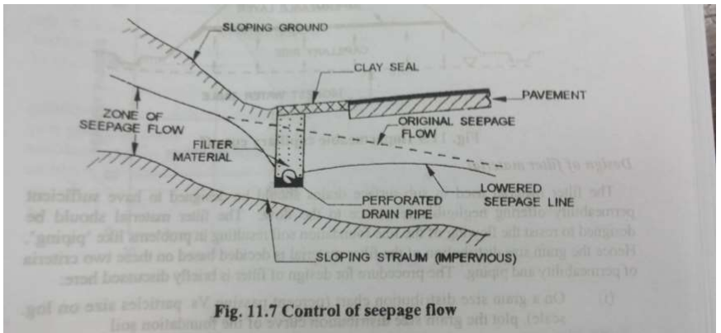
Drainage to control seepage flow
When the general ground as well as impervious strata below are sloping, seepage flow is likely to exist.
If seepage zone is at depth less than 0.6-0.9 m from sub-grade level, longitudinal pipe drain in trench filled with filter material and clay seal may be constructed to intercept the flow.

